Slide 1
EEE 342/ETE418
Control Engineering
Fall 2019
Lecture # 02
30 September 2019

Slide 2
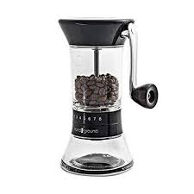
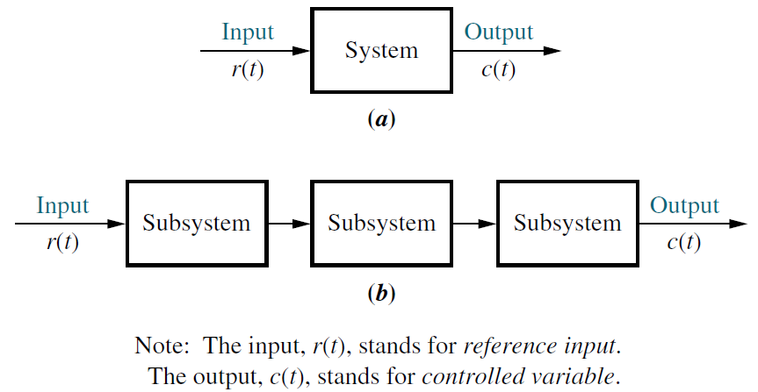
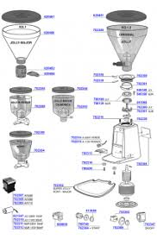
System

Slide 3
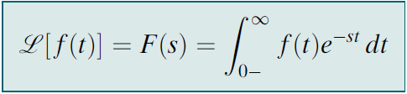
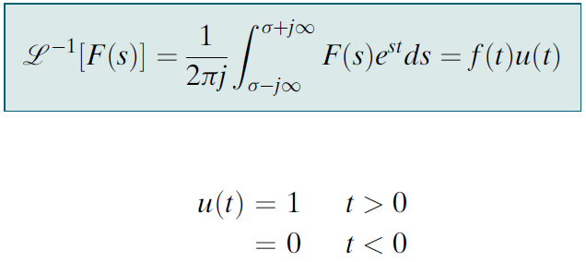
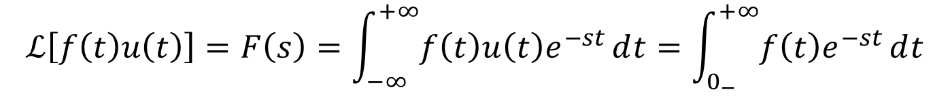
Laplace transform
$$ℒ\left[f\left(t\right)u\left(t\right)\right]=F\left(s\right)=\int_{−∞}^{+∞}{f\left(t\right)u\left(t\right)e^{−st}}ⅆt=\int_{0_{−}}^{+∞}{f\left(t\right)e^{−st}}ⅆt$$

Slide 4
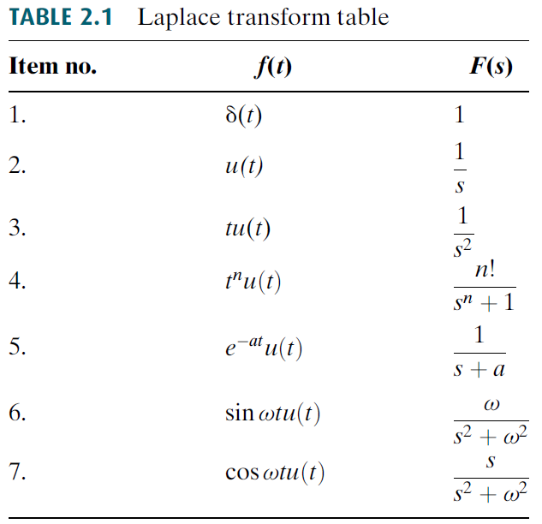
Laplace transform table

Slide 5
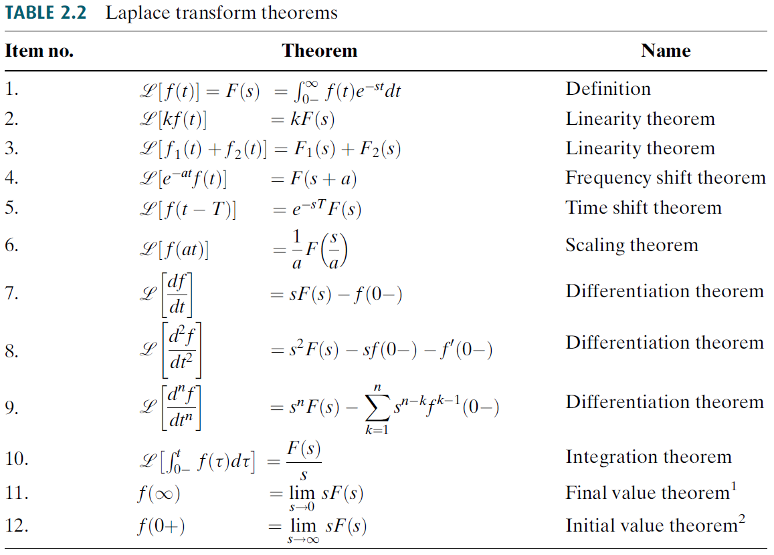
Laplace transform theorems

Slide 6
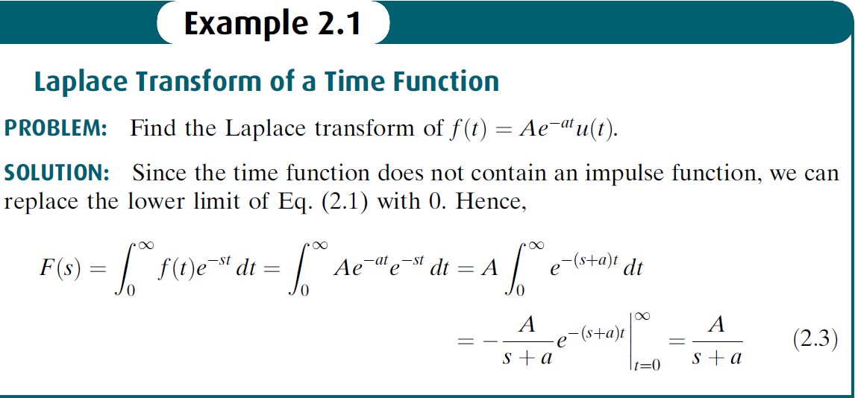
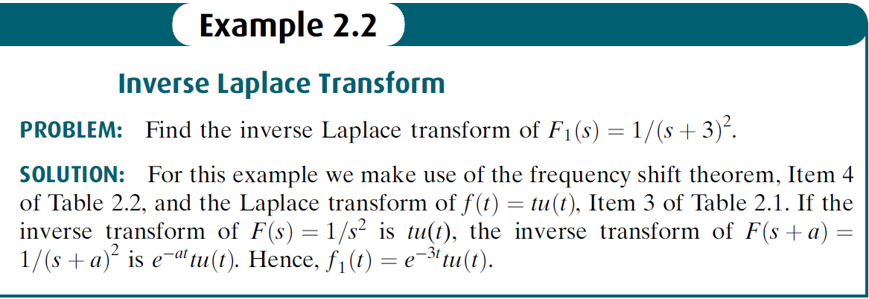
Examples

Slide 7




Partial-Fraction Expansion

Slide 8





Case 1. Roots of the Denominator of F(s) Are Real and Distinct

Slide 9
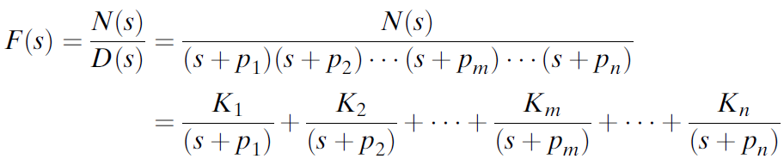
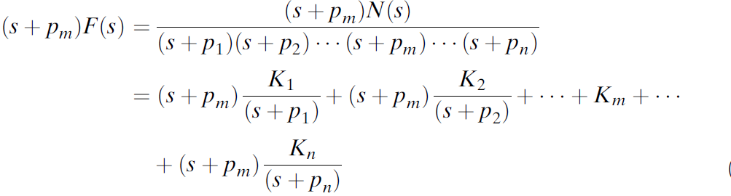

Case 1. Roots of the Denominator of F(s) Are Real and Distinct

Slide 10









Example 2.3

Slide 11


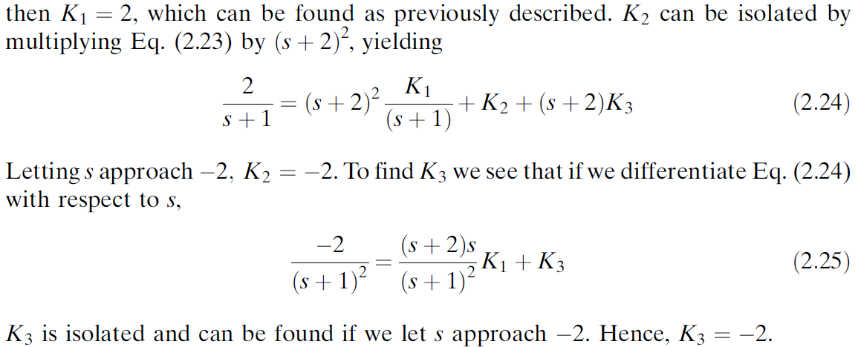

Case 2. Roots of the Denominator of F(s) Are Real and Repeated

Slide 12
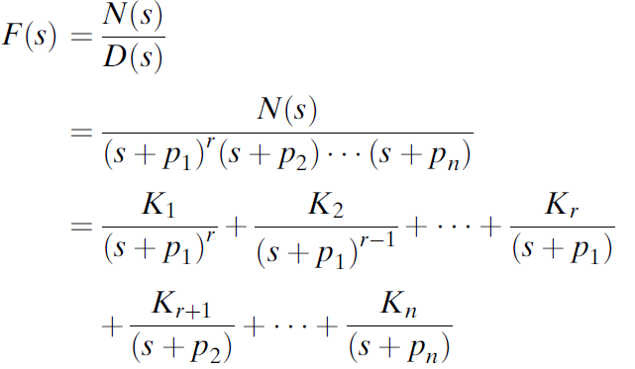
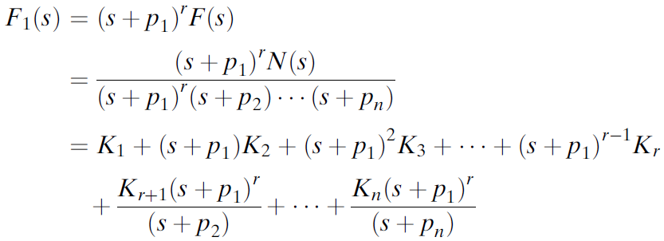

Case 2. Roots of the Denominator of F(s) Are Real and Repeated

Slide 13




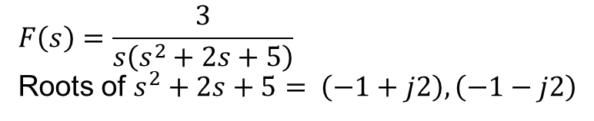
Case 3. Roots of the Denominator of F(s) Are Complex or Imaginary
$$F\left(s\right)=\frac{3}{s\left(s^{2}+2s+5\right)}$$
Roots of $s^{2}+2s+5= \left(−1+j2\right),\left(−1−j2\right)$

Slide 14
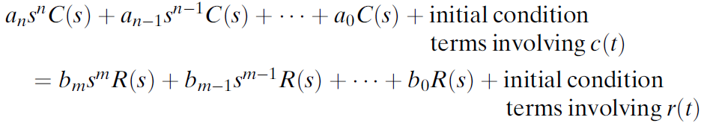
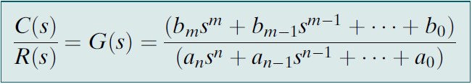


The Transfer Function

Slide 15






Example

Slide 16
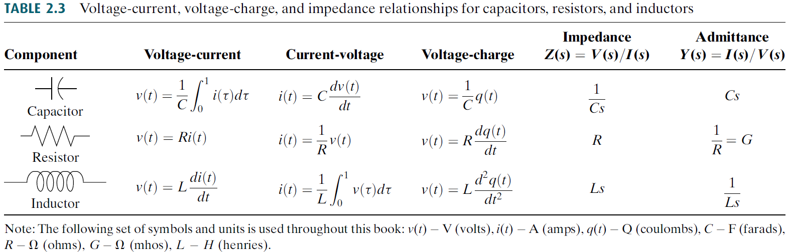
Electrical Network Transfer Functions

Slide 17
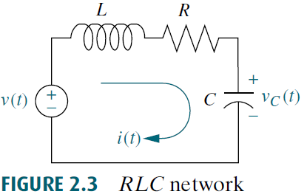






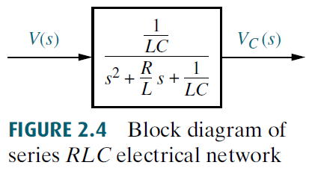
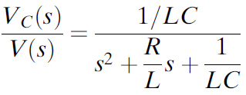
Transfer Function—Single Loop via the Differential Equation

Slide 18
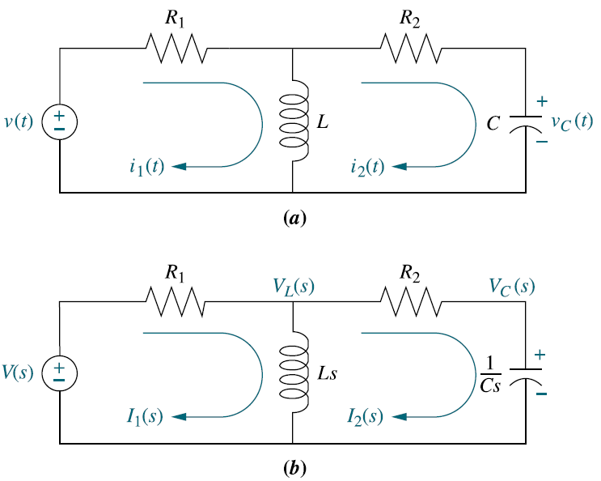

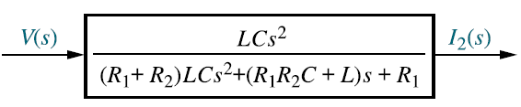
Example 2.10
Transfer Function—Multiple Loops

